Slide 2
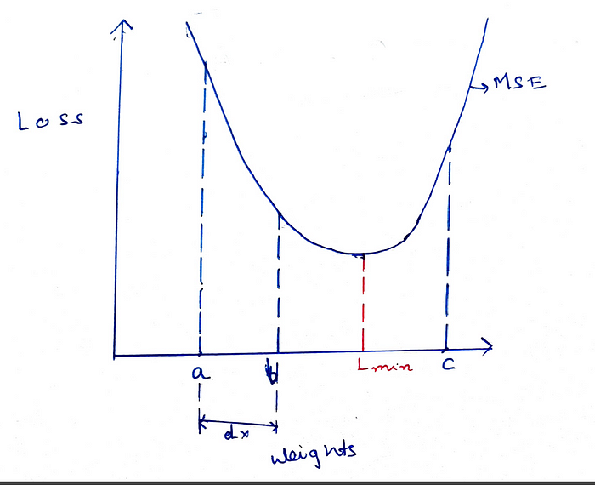

Slide 3

Neural networks are a set of algorithms that are designed to recognize trends/relationships in a given set of training data.
These algorithms are based on the way human neurons process information.
This equation represents how a neural network processes the input data at each layer and eventually produces a predicted output value.
To train — the process by which the model maps the relationship between the training data and the outputs.
the neural network updates its hyperparameters, the weights, wT, and biases, b, to satisfy the equation above.

Slide 4
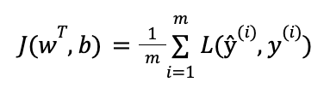
Each training input is loaded into the neural network in a process called forward propagation. Once the model has produced an output, this predicted output is compared against the given target output in a process called backpropagation — the hyperparameters of the model are then adjusted so that it now outputs a result closer to the target output.
This is where loss functions come in.
A loss function is a function that compares the target and predicted output values; measures how well the neural network models the training data.
When training, we aim to minimize this loss between the predicted and target outputs.
The hyperparameters are adjusted to minimize the average loss — we find the weights, wT, and biases, b, that minimize the value of J (average loss).

Slide 5
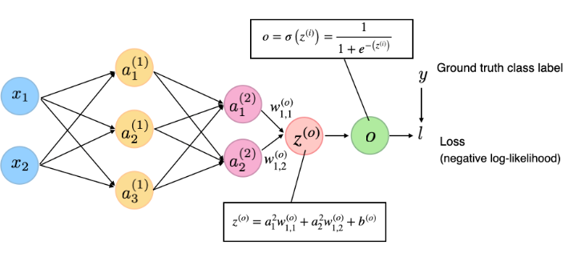

Slide 6
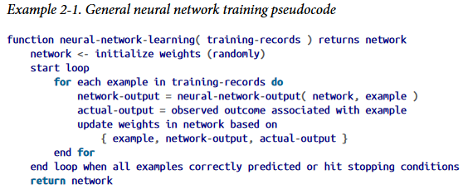

Slide 7
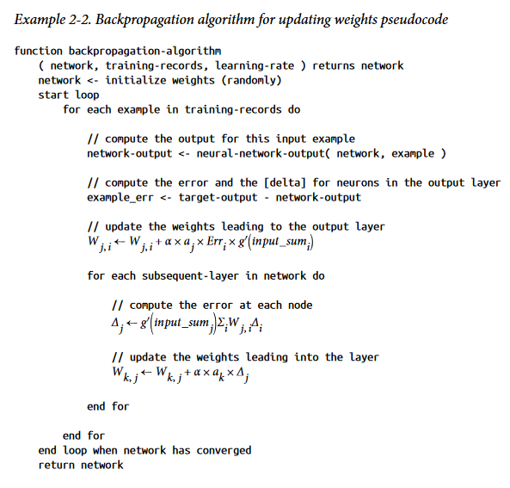

Slide 8
Convergence
In deep learning, convergence refers to the point at which the training process reaches a stable state and the parameters of the network (i.e., the weights and biases) have settled on values that produce accurate predictions for the training data.
A neural network can be considered to have converged when the training error (or loss) stops decreasing or has reached a minimum level of acceptable error.

Slide 9
Activation Function
is a mathematical function applied to the output of a neuron.
use activation functions to propagate the output of one layer’s nodes forward to the next layer (up to and including the output layer).
use in the hidden layer as well as at the output layer of the network.
to introduce non-linearity into the model, allowing the network to learn and represent complex patterns in the data

Slide 10
Linear :the equation similar to as of a straight line i.e. y = x,
Range : -inf to +inf
Uses : Linear activation function is used at just one place i.e. output layer.
Sigmoid : Equation : A = 1/(1 + e^{-x})
Nature : Non-linear.
Value Range : 0 to 1
Uses : Usually used in output layer of a binary classification, where result is either 0 or 1, as value for sigmoid function lies between 0 and 1 only so, result can be predicted easily to be 1 if value is greater than 0.5 and 0 otherwise.
Tanh : Tangent Hyperbolic function.
f(x) = tanh(x) = 2/(1 + e-2x) – 1 OR tanh(x) = 2 * sigmoid(2x) – 1
Value Range :- -1 to +1
Nature :- non-linear
Uses :- Usually used in hidden layers
Hard Tanh: Similar to tanh, hard tanh simply applies hard caps to the normalized range. Anything more than 1 is made into 1, and anything less than –1 is made into –1. It is a cheaper and more computationally efficient version of the tanh activation.
Softmax:
The softmax function is also a type of sigmoid function but is handy when we are trying to handle multi- class classification problems.
Nature :- non-linear
Uses :- Usually used when trying to handle multiple classes. the softmax function was commonly found in the output layer of image classification problems.
The softmax function would squeeze the outputs for each class between 0 and 1 and would also divide by the sum of the outputs.
Output:- The softmax function is ideally used in the output layer of the classifier where we are actually trying to attain the probabilities to define the class of each input.
ReLU : Rectified linear unit.
Equation :- A(x) = max(0,x). It gives an output x if x is positive and 0 otherwise. implemented in hidden layers
Value Range :- [0, inf)
Nature :- non-linear, which means we can easily backpropagate the errors and have multiple layers of neurons being activated by the ReLU function.
Uses :- ReLu is less computationally expensive than tanh and sigmoid because it involves simpler mathematical operations.. RELU learns much faster than sigmoid and Tanh function.

Slide 11

Leaky ReLU:
Softplus : smooth version of the ReLU.
(f(x) = ln[ 1 + exp(x) ])
The basic rule of thumb is if you really don’t know what activation function to use, then simply use RELU as it is a general activation function in hidden layers and is used in most cases these days.
If your output is for binary classification then, sigmoid function is very natural choice for output layer.
If your output is for multi-class classification then, Softmax is very useful to predict the probabilities of each classes.

Slide 12
Loss Function for regression
Mean Squared Error Loss Function
Mean Absolute Error Loss
Mean Absolute Percentage Error loss
Mean Squared log error loss

Slide 13
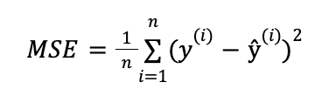

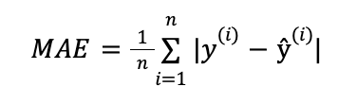
Mean Squared Error Loss Function:
sensitive to outliers in the data, making it less suitable for some tasks.
Mean Absolute Error (MAE)
MAE finds the average of the absolute differences between the target and the predicted outputs.

Slide 14

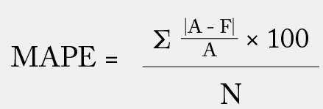
Mean Squared Logarithmic Error Loss
Mean squared logarithmic error (MSLE) loss is a function used for regression tasks. It is similar to mean squared error (MSE) loss, but it takes the logarithm of the predicted output before squaring the difference between the predicted and true values.
The following equation gives the MSLE loss
Mean Absolute Percentage Error (MAPE) or mean absolute percentage deviation (MAPD)
Where:
N is the number of fitted points;
A is the actual value;
F is the forecast value; and
Σ is summation notation (the absolute value is summed for every forecasted point in time).

Slide 15

Loss Function for classification
Binary classification loss functions in neural networks are functions that are used to evaluate the performance of a machine learning model on a binary classification task. Binary classification is a machine learning task involving predicting a binary outcome, such as a Yes/No decision or a 0/1 label.
Binary Cross-Entropy:
Binary cross-entropy loss is a loss function used for binary classification tasks. It is defined as the negative log probability of the true class. It is calculated by taking the negative log of the predicted probability of the true class.
The mathematical formulation for binary cross-entropy loss is:
Hinge Loss: (mostly for binary clsssification)
Hinge loss is a function that trains linear classifiers, such as support vector machines (SVMs). It is the maximum difference between the predicted and true margins and a constant value. The predicted margin is the distance between the decision boundary and the closest training data point. The true margin is the distance between the decision boundary and the true label.
The following equation gives the hinge loss:
Hinge Loss=𝑚𝑎𝑥(0,1−𝑦𝑡_{𝑟𝑢𝑒}∗𝑦_{𝑝𝑟𝑒𝑑})Hinge Loss=max(0,1−y_{true}​∗y_{pred}​)

Slide 16
Logistic loss
Negative log likelihood

Slide 17

Loss function for Reconstruction
The reconstruction loss, on the other hand, is pivotal in unsupervised learning, particularly in models like autoencodersthat learn efficient data coding in an unsupervised manner. This loss function measures how well the output of the model can reconstruct the original input data after being encoded and decoded.
Kullback-Leibler (KL) divergence, or relative entropy, is a metric used to compare two data distributions. It is a concept of information theory that contrasts the information contained in two probability distributions.
Divergence in Statistics
The divergence between two probability distributions quantifies how much the two differ from each other.

Slide 18
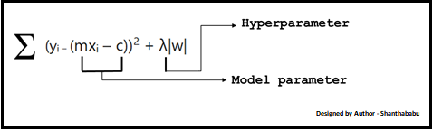
Hyperparameters in Machine Learning
Hyperparameters in Machine learning are those parameters that are explicitly defined by the user to control the learning process.
These hyperparameters are used to improve the learning of the model, and their values are set before starting the learning process of the model.
prefix "hyper" suggests that the parameters are top-level parameters that are used in controlling the learning process. The value of the Hyperparameter is selected and set by the machine learning engineer before the learning algorithm begins training the model. Hence, these are external to the model, and their values cannot be changed during the training process.

Slide 19
Some common examples
The k in kNN or K-Nearest Neighbour algorithm
Layer size
Layer size is defined by the number of neurons in a given layer
Learning rate for training a neural network
Train-test split ratio
Batch Size
Number of Epochs
Branches in Decision Tree
Number of clusters in Clustering Algorithm
The choice of cost or loss function the model will use
Choice of activation function in a neural network (nn) layer (e.g. Sigmoid, ReLU, Tanh)
The k in kNN or K-Nearest Neighbour algorithm
Learning rate for training a neural network
Train-test split ratio
Batch Size
Number of Epochs
Branches in Decision Tree
Number of clusters in Clustering Algorithm
Choice of optimization algorithm (e.g., gradient descent, stochastic gradient descent, or Adam optimizer)
Number of hidden layers in a nn
Number of activation units in each layer
The drop-out rate in nn (dropout probability)
Number of iterations (epochs) in training a nn
Number of clusters in a clustering task
Kernel or filter size in convolutional layers
Pooling size

Slide 20
Model Parameters:
Model parameters are configuration variables that are internal to the model, and a model learns them on its own.
For example,
The coefficients (or weights) of linear and logistic regression models.
Weights and biases of a nn
The cluster centroids in clustering
Some key points for model parameters are as follows:
They are used by the model for making predictions.
They are learned by the model from the data itself
These are usually not set manually.
These are the part of the model and key to a machine learning Algorithm.

Slide 21
Categories of Hyperparameters:
Broadly hyperparameters can be divided into two categories, which are given below:
Hyperparameter for Optimization
Hyperparameter for Specific Models
Hyperparameter for Optimization
The process of selecting the best hyperparameters to use is known as hyperparameter tuning, and the tuning process is also known as hyperparameter optimization. Optimization parameters are used for optimizing the model.
Learning Rate: The learning rate is the hyperparameter in optimization algorithms that controls how much the model needs to change in response to the estimated error for each time when the model's weights are updated. It is one of the crucial parameters while building a neural network, and also it determines the frequency of cross-checking with model parameters. Selecting the optimized learning rate is a challenging task because if the learning rate is very less, then it may slow down the training process. On the other hand, if the learning rate is too large, then it may not optimize the model properly.
Note: Learning rate is a crucial hyperparameter for optimizing the model, so if there is a requirement of tuning only a single hyperparameter, it is suggested to tune the learning rate.
Batch Size: To enhance the speed of the learning process, the training set is divided into different subsets, which are known as a batch. Number of Epochs: An epoch can be defined as the complete cycle for training the machine learning model. Epoch represents an iterative learning process. The number of epochs varies from model to model, and various models are created with more than one epoch. To determine the right number of epochs, a validation error is taken into account. The number of epochs is increased until there is a reduction in a validation error. If there is no improvement in reduction error for the consecutive epochs, then it indicates to stop increasing the number of epochs. Batch size refers to the number of training instances in the batch. For example, batch_size=128 means that there are 128 training instances in each batch.

Slide 22
Hyperparameter for Specific Models:
Hyperparameters that are involved in the structure of the model are known as hyperparameters for specific models.
These are given below:
A number of Hidden Units: Hidden units are part of neural networks, which refer to the components comprising the layers of processors between input and output units in a neural network.
It is important to specify the number of hidden units hyperparameter for the neural network. It should be between the size of the input layer and the size of the output layer. More specifically, the number of hidden units should be 2/3 of the size of the input layer, plus the size of the output layer.
Number of Layers: A neural network is made up of vertically arranged components, which are called layers. There are mainly input layers, hidden layers, and output layers. A 3-layered neural network gives a better performance than a 2-layered network. For a Convolutional Neural network, a greater number of layers make a better model.

Slide 23
Hyperparameter Tuning
Hyperparameter tuning is the process of selecting the optimal values for a machine learning model’s hyperparameters.
Hyperparameters are settings that control the learning process of the model, such as the learning rate, the number of neurons in a neural network, or the kernel size in a support vector machine.
The goal of hyperparameter tuning is to find the values that lead to the best performance on a given task.

Slide 24
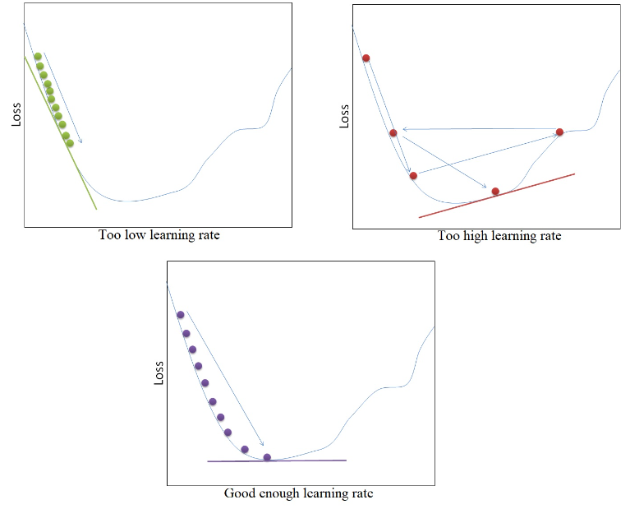
Learning rate
The learning rate is a scalar value that determines the size of the step taken in the direction of the negative gradient during backpropagation.
Learning rate controls the step size for a model to reach the minimum loss function.
The learning rate is the hyperparameter in optimization algorithms that controls how much the model needs to change in response to the estimated error for each time when the model's weights are updated.
A higher learning rate makes the model learn faster, but it may miss the minimum loss function and only reach the surrounding of it.
A lower learning rate gives a better chance to find a minimum loss function.

Slide 25
Why is the learning rate needed?
The learning rate is needed because it controls how much the weights of a neural network are updated each time the model is trained.
A higher learning rate will cause the weights to be updated more aggressively, while a lower learning rate will cause the weights to be updated more slowly.

Slide 26
Number of times dataset:
The number of times a complete dataset passes through the neural network model is referred to as an epoch.
Essentially, one epoch involves the training dataset moving forward and backward through the neural network once. If the number of epochs is too small, it may result in underfitting, indicating that the neural network hasn’t learned sufficiently. Multiple passes or epochs are necessary for effective learning.
Conversely, excessive epochs can lead to overfitting, where the model excels in predicting existing data but struggles with new, unseen data. Tuning the number of epochs is crucial for optimal results.
Find the ideal number of epochs within the range of 20 to 100, emphasizing the importance of hyperparameters in deep learning in neural networks.
The ideal learning rate depends on a number of factors, including the size of the neural network, the complexity of the problem, and the amount of training data. In general, a good starting point is to use a learning rate of 0.01. However, it may be necessary to experiment with different learning rates to find the best value for a particular model.

Slide 27
Methods for Selecting an appropriate learning rate
Fixed Learning Rate
Using a set learning rate throughout the training phase is the simplest method for choosing a learning rate.
Learning Rate Scheduling
To increase convergence speed and solution quality, the learning rate schedule calls for gradually lowering the learning rate.
Scheduling techniques for learning rate include −
Step decay − After a certain number of epochs, the learning rate is lowered by a defined factor.
Exponential decay − With time, the learning rate decreases exponentially.
Performance-based decay − Based on the validation error or other performance parameters, the learning rate is decreased.
Adaptive Learning Rates
Based on the gradient data or other performance measures, adaptive learning rate algorithms change the learning rate during training.
The below are typical approaches for adjusting your learning rate −
Adagaurd − This approach, also known as Adagrad, modifies the learning rate for each weight based on the amount of the gradient updates for each weight.
RMSProp − Using a moving average of the squared gradient updates, this approach modifies the learning rate.
Adam − This approach utilizes a more advanced adaptive learning rate system and combines the advantages of RMSProp and Adagrad.
Compared to fixed learning rate approaches, adaptive learning rate methods can be more computationally expensive while simultaneously enhancing convergence speed and solution quality.

Slide 28
Regularization
Regularization is a set of methods for reducing overfitting by adding extra information to it in machine learning models.
In regularization, we just add an extra term to our cost function which is the Frobenius norm of the weight matrix W. The parameter lambda is called as the regularization parameter which denotes the degree of regularization. Setting lambda to 0 results in no regularization, while large values of lambda correspond to more regularization. Lambda is usually set using cross validation.
It mainly regularizes or reduces the coefficient of features toward zero. In simple words, "In regularization technique, we reduce the magnitude of the features by keeping the same number of features.“
Popular regularization techniques include L1, L2, Dropout, and Batch Normalization.

Slide 29
Dropout regularization:
Dropout works by randomly removing a certain percentage of neurons from the network during training.
This forces the network to learn multiple independent data representations, as the neurons are randomly removed and replaced during each training cycle.
Early stopping
Early stopping is a regularization technique used in machine learning to stop a model's training when the validation loss stops improving. This technique prevents overfitting and can be used with any supervised learning algorithm. Early stopping works by monitoring the validation error of the model during training and stopping when the validation error stops decreasing.
The main advantage of early stopping is that it can prevent overfitting and help to avoid wasting time and resources on training a model that will not improve its performance.

Slide 30
Batch Normalization: Batch Normalization is a technique that normalizes the inputs to a layer in a neural network. It works by normalizing each batch of inputs with the mean and variance of the batch. This helps move the model's convergence speed and avoids overfitting. The drawback of this strategy is that it requires extra computation and memory, which can be costly.

Slide 31
L1 and L2 regularization
Regularization is a technique used in machine learning and deep learning to prevent overfitting and improve the generalization performance of a model. It involves adding a penalty term to the loss function during training
L1 Regularization(LASSO):
Penalizes the absolute value of the weight coefficients
Minimizes the sum of the absolute weights of the coefficients
This leads to sparse models, with many weights set to zero
Also known as L1 norm and Least Absolute Shrinkage and Selection Operator (LASSO)
L2 Regularization(Ridge):
Penalizes the square of the weight coefficients
Minimizes the sum of the squared weights of the coefficients
This leads to small, but non-zero weights
Also known as L2 norm and Ridge Regression

Slide 32
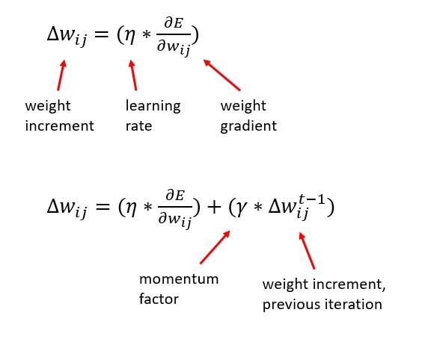
Momentum
Momentum in neural networks is a parameter optimization technique that accelerates gradient descent by adding a fraction of the previous update to the current update.
Momentum in neural networks is a variant of the stochastic gradient descent.
It is also the common name given to the momentum factor, as in your case.
Maths
The momentum factor is a coefficient that is applied to an extra term in the weights update:
Advantages
Beside others, momentum is known to speed up learning and to help not getting stuck in local minima.
Neural Network Momentum Using Python -- Visual Studio Magazine

Slide 33
Stochastic gradient descent is an iterative learning algorithm that uses a training dataset to update a model.
The batch size is a hyperparameter of gradient descent that controls the number of training samples to work through before the model’s internal parameters are updated.
The number of epochs is a hyperparameter of gradient descent that controls the number of complete passes through the training dataset.
Overview
This post is divided into five parts; they are:
Stochastic Gradient Descent
What Is a Sample?
What Is a Batch?
What Is an Epoch?
What Is the Difference Between Batch and Epoch?

Slide 34
Stochastic Gradient Descent
Stochastic Gradient Descent, or SGD for short, is an optimization algorithm used to train machine learning algorithms, most notably artificial neural networks used in deep learning.
The job of the algorithm is to find a set of internal model parameters that perform well against some performance measure such as logarithmic loss or mean squared error.
Optimization is a type of searching process and you can think of this search as learning. The optimization algorithm is called “gradient descent“, where “gradient” refers to the calculation of an error gradient or slope of error and “descent” refers to the moving down along that slope towards some minimum level of error.
The algorithm is iterative. This means that the search process occurs over multiple discrete steps, each step hopefully slightly improving the model parameters.
Each step involves using the model with the current set of internal parameters to make predictions on some samples, comparing the predictions to the real expected outcomes, calculating the error, and using the error to update the internal model parameters.
This update procedure is different for different algorithms, but in the case of artificial neural networks, the backpropagation update algorithm is used.
Before we dive into batches and epochs, let’s take a look at what we mean by sample.

Slide 35
Sparsity
The sparsity hyperparameter recognizes that for some inputs only a few features are
relevant.
For example, let’s assume that a network can classify a million images. Any
one of those images will be indicated by a limited number of features.
But to effectively classify millions of images a network must be able to recognize considerably more features, many of which don’t appear most of the time. An example of this would be how photos of sea urchins don’t contain noses and hooves. This contrasts to how in submarine images the nose and hoof features will be 0.
because sparse features can limit the number of nodes that activate and impede a network’s ability to learn. In response to sparsity, biases force neurons to activate and the activations stay around a mean that keeps the network from becoming stuck

Slide 36
Common Architectural Principles of Deep Networks
Core components:
Parameters
Layers
Activation functions
Loss functions
Optimization methods
Hyperparameters
Building block networks of deep networks, such as the following:
RBMs
Autoencoders
specific deep network architectures:
UPNs
CNNs
Recurrent neural networks
Recursive neural networks

Slide 37
Optimization Algorithms:
process of adjusting weights to produce more and more accurate guesses about the data is known as parameter optimization
Training a model in machine learning involves finding the best set of values for the parameter vector of the model.
We can think of machine learning as an optimization problem in which we minimize the loss function with respect to the parameters of our prediction function (based on our model).

Slide 38
divide optimization algorithms into two camps:
First-order
• Second-order
First-order optimization algorithms calculate the Jacobian matrix.
The Jacobian
The Jacobian is a matrix of partial derivatives of loss function val‐
ues with respect to each parameter.
The Jacobian has one partial derivative per parameter (to calculate partial derivatives, all other variables are momentarily treated as constants). The algorithm then takes one step in the direction specified by the Jacobian.
Second-order algorithms calculate the derivative of the Jacobian (i.e., the derivative of a matrix of derivatives) by approximating the Hessian. Second-order methods take into account interdependencies between parameters when choosing how much to modify each parameter Other Optimization Algorithms
There are other variations of optimization algorithms (such as “meta heuristics”) that we won’t cover in this book. They include
the following:
• Genetic algorithms
• Particle swarm optimization
• Ant colony optimization
• Simulated annealing

Slide 39
Building Blocks of Deep Networks:
deep networks combine smaller networks as building blocks into larger networks.
RBMs: (Restricted Boltzmann Machines)
RBMs are used in deep learning for the following:
Feature extraction
Dimensionality reduction
Network layout
There are five main parts of a basic RBM:
Visible units
Hidden units
Weights
Visible bias units
Hidden bias units

Slide 40
RBM
is a type of artificial neural network that is used for unsupervised learning.
It is a type of generative model that is capable of learning a probability distribution over a set of input data.
Consists of two layers of neurons – a visible layer and a hidden layer. The visible layer represents the input data, while the hidden layer represents a set of features that are learned by the network.
The RBM is called “restricted” because the connections between the neurons in the same layer are not allowed. In other words, each neuron in the visible layer is only connected to neurons in the hidden layer, and vice versa. This allows the RBM to learn a compressed representation of the input data by reducing the dimensionality of the input.
The RBM is trained using a process called contrastive divergence, which is a variant of the stochastic gradient descent algorithm. During training, the network adjusts the weights of the connections between the neurons in order to maximize the likelihood of the training data. Once the RBM is trained, it can be used to generate new samples from the learned probability distribution.
RBM has found applications in a wide range of fields, including computer vision, natural language processing, and speech recognition. It has also been used in combination with other neural network architectures, such as deep belief networks and deep neural networks, to improve their performance.
In Boltzmann machine, there is no output layer. Boltzmann machines are random and generative neural networks capable of learning internal representations and are able to represent and (given enough time) solve tough combinatoric problems.
it is also known as Energy-Based Models (EBM)

Slide 41
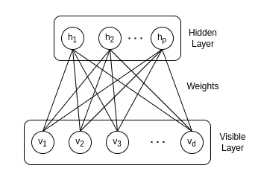
The set of neurons in the hidden layer represents the probability distribution across the input data. During training, the system updates the weights between the layers aiming to reproduce the desired output values. The purpose of each neuron in the visible layer is to observe a pattern of data, while the neurons in the hidden layer are used to explain the pattern observed by the visible neurons.

Slide 42
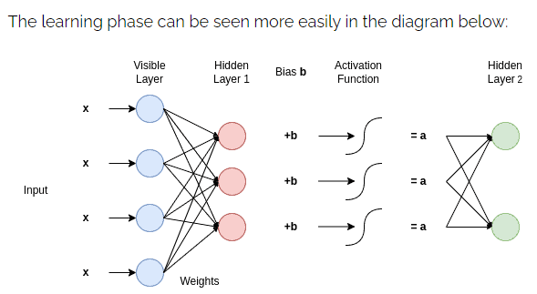
As we can see the input is multiplied by the weights of the two consecutive layers. Therefore each hidden layer receives those products, sums them, and adds a bias to each node of the hidden layer. Then, the result is driven into an activation function and then passed into the next hidden layer.
Therefore the learning phase considers updating and adjusting the weights between each consecutivelayer in order to find the probability distribution that best models the input data.

Slide 43
A generative model is a type of machine learning model that aims to learn the underlying patterns or distributions of data in order to generate new, similar data.
In essence, it's like teaching a computer to dream up its own data based on what it has seen before.

Slide 44
Other uses of RBMs
Here are some other places we see RBMs used:
Dimensionality reduction
Classification
Regression
Collaborative filtering
Topic modelling

Slide 45
Autoencoders
Autoencoders are a specialized class of algorithms that can learn efficient representations of input data with no need for labels. It is a class of artificial neural networks designed for unsupervised learning.
use autoencoders to learn compressed representations of datasets
use them to reduce a dataset’s dimensionality.
The output of the autoencoder network is a reconstruction of the input data in the most efficient form.

Slide 46
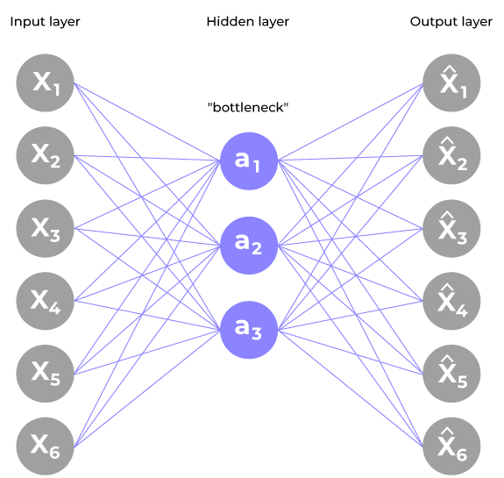
Encoder
Input layer take raw input data
The hidden layers progressively reduce the dimensionality of the input, capturing important features and patterns. These layer compose the encoder.
The bottleneck layer (latent space) is the final hidden layer, where the dimensionality is significantly reduced. This layer represents the compressed encoding of the input data.
Decoder
The bottleneck layer takes the encoded representation and expands it back to the dimensionality of the original input.
The hidden layers progressively increase the dimensionality and aim to reconstruct the original input.
The output layer produces the reconstructed output, which ideally should be as close as possible to the input data.
The loss function used during training is typically a reconstruction loss, measuring the difference between the input and the reconstructed output.
Common choices include mean squared error (MSE) for continuous data or binary cross-entropy for binary data.
During training, the autoencoder learns to minimize the reconstruction loss, forcing the network to capture the most important features of the input data in the bottleneck layer.

Slide 47
Similarities to multilayer perceptrons
Autoencoders share a strong resemblance with multilayer perceptron neural networks in that they have an input layer, hidden layers of neurons, and then an output layer.
The key difference to note between a multilayer perceptron network diagram (from earlier chapters) and an autoencoder diagram is the output layer in an autoencoder has the same number of units as the input layer does.

Slide 48
Defining features of autoencoders:
Autoencoders differ from multilayer perceptrons in a couple of ways:
They use unlabeled data in unsupervised learning.
They build a compressed representation of the input data.
Varients of Autoencoder:
Compression encoder
Denoising encoder
Variational autoencoders

Slide 49
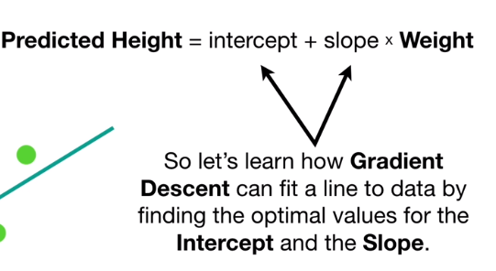
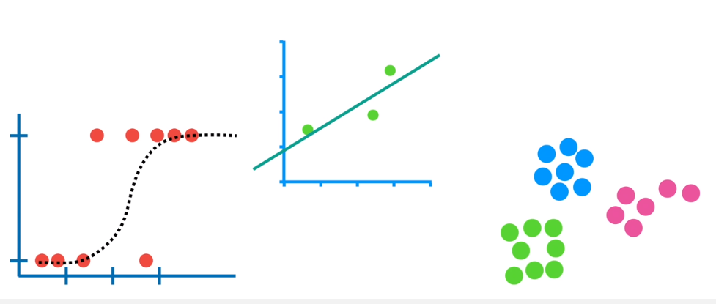
Gradient Descent
In LR, we optimize the slope and intersect.
In logistic regression, we optimize the squiggle
Then in some other, optimize the cluster.
Using Gradient descen, will optimize all these things like (slope, intercept), (clusters) etc.,

